Slide 1
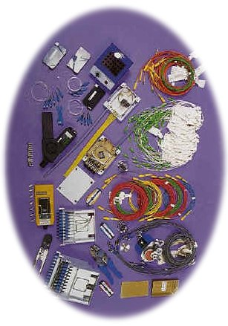
Fiber Optics Technology

Slide 2
Optical Communication Systems
Communication systems with light as the carrier and optical fiber as communication medium
Optical fiber is used to contain and guide light waves
  Typically made of glass or plastic
  Propagation of light in atmosphere is impractical
    This is similar to cable guiding electromagnetic waves
Capacity comparison
  Microwave at 10 GHz
  Light at 100 Tera Hz (10¹⁴ )

Slide 3
History
1880 Alexander G. Bell
  Photo phone, transmit sound waves over beam of light
1930: TV image through uncoated fiber cables
  Few years later image through a single glass fiber
1951: Flexible fiberscope: Medical applications
1956: The term “fiber optics” used for the first time
1958: Paper on Laser & Maser

Slide 4
History Cont’d
1960: Laser invented
1967: New Communications medium: cladded fiber
1960s: Extremely lossy fiber:
  More than 1000 dB /km
1970: Corning Glass Work NY, Fiber with loss of less than 2 dB/km
70s & 80s : High quality sources and detectors
Late 80s : Loss as low as 0.16 dB/km
1990: Deployment of SONET systems

Slide 5
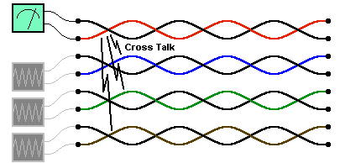
Optical Fiber: Advantages
Capacity: much wider bandwidth (10 GHz)
Crosstalk immunity
Immunity to static interference
  Lightening
  Electric motor
  Florescent light
Higher environment immunity
  Weather, temperature, etc.
http://www.tpub.com/neets/book24/index.htm

Slide 6
Optical Fiber: Advantages
Safety: Fiber is non-metalic
  No explosion, no chock
Longer lasting
Security: tapping is difficult
Economics: Fewer repeaters
  Low transmission loss (dB/km)
  Fewer repeaters
  Less cable
Remember: Fiber is non-conductive
Hence, change of magnetic field has
No impact!
http://www.tpub.com/neets/book24/index.htm

Slide 7
Disadvantages
Higher initial cost in installation
Interfacing cost
Strength
  Lower tensile strength
Remote electric power
More expensive to repair/maintain
  Tools: Specialized and sophisticated

Slide 8
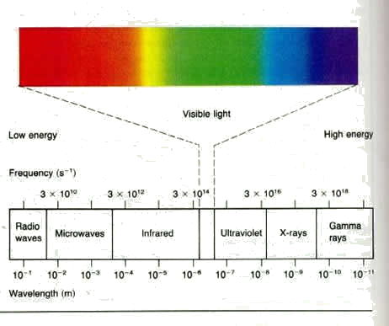
Light Spectrum
Light frequency is divided into three general bands
Remember:
  When dealing with light we use wavelength:
    λ=c/f
    c=300E6 m/sec

Slide 9
Optical Fiber Architecture
TX, RX, and Fiber Link
Transmitter
Input
Signal
Coder or
Converter
Light
Source
Source-to-Fiber
Interface
Fiber-optic Cable
Fiber-to-light
Interface
Light
Detector
Amplifier/Shaper
Decoder
Output
Receiver

Slide 10
Optical Fiber Architecture –
Components
Light source:
  Amount of light emitted is proportional to the drive current
  Two common types:
    LED (Light Emitting Diode)
    ILD (Injection Laser Diode)
Source–to-fiber-coupler (similar to a lens):
  A mechanical interface to couple the light emitted by the source into the optical fiber
Input
Signal
Coder or
Converter
Light
Source
Source-to-Fiber
Interface
Fiber-optic Cable
Fiber-to-light
Interface
Light
Detector
Amplifier/Shaper
Decoder
Output
Receiver
Light detector:
  PIN (p-type-intrinsic-n-type)
  APD (avalanche photo diode)
  Both convert light energy into current

Slide 11
Light Sources (more details…)
Light-Emitting Diodes (LED)
  made from material such as AlGaAs or GaAsP
  light is emitted when electrons and holes recombine
  either surface emitting or edge emitting
Injection Laser Diodes (ILD)
  similar in construction as LED except ends are highly polished to reflect photons back & forth

Slide 12
ILD versus LED
Advantages:
  more focussed radiation pattern; smaller Fiber
  much higher radiant power; longer span
  faster ON, OFF time; higher bit rates possible
  monochromatic light; reduces dispersion
Disadvantages:
  much more expensive
  higher temperature; shorter lifespan

Slide 13
Light Detectors
PIN Diodes
  photons are absorbed in the intrinsic layer
  sufficient energy is added to generate carriers in the depletion layer for current to flow through the device
Avalanche Photodiodes (APD)
  photogenerated electrons are accelerated by relatively large reverse voltage and collide with other atoms to produce more free electrons
  avalanche multiplication effect makes APD more sensitive but also more noisy than PIN diodes

Slide 14
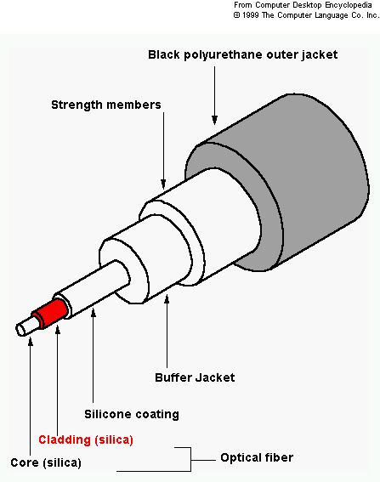
Optical Fiber Construction
Core – thin glass center of the fiber where light travels.
Cladding – outer optical material surrounding the core
Buffer Coating – plastic
coating that protects
the fiber.

Slide 15
Fiber Types
Core
Cladding
Plastic core and cladding
Glass core with plastic cladding PCS (Plastic-Clad Silicon)
Glass core and glass cladding SCS: Silica-clad silica
Under research: non silicate: Zinc-chloride
  1000 time as efficient as glass

Slide 16
Plastic Fiber
Used for short distances
Higher attenuation, but easy to install
Better withstand stress
Less expensive
60% less weight

Slide 17
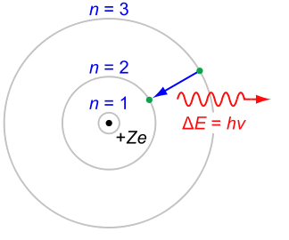
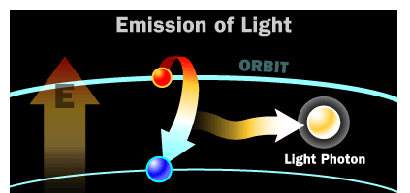
A little about Light
When electrons are excited and moved to a higher energy state they absorb energy
When electrons are moved to a lower energy state → loose energy → emit light
  photon of light is generated
Energy (joule) = h.f
  Planck’s constant: h=6.625E-23 Joule.sec
  f is the frequency
ΔE=h.f
http://www.student.nada.kth.se/~f93-jhu/phys_sim/compton/Compton.htm

Slide 18
Optical Power
Flow of light energy past a given point in a specific time
Expresses in dBm or dBμ (refer to your notes)
Example:

Slide 19
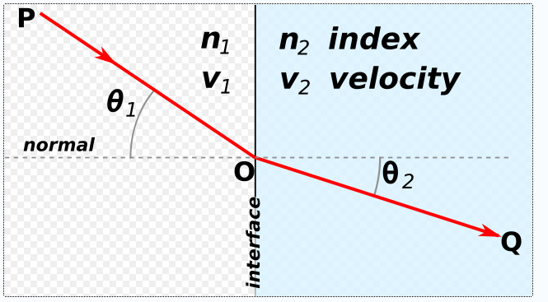

Refraction
Refraction is the change in direction of a wave due to a change in its speed
Refraction of light is the most commonly seen example
  Any type of wave can refract when it interacts with a medium
Refraction is described by Snell's law, which states that the angle of incidence is related to the angle of refraction by :
The index of refraction is defined as the speed of light in vacuum divided by the speed of light in the medium: n=c/v
http://hyperphysics.phy-astr.gsu.edu/Hbase/geoopt/refr.html

Slide 20
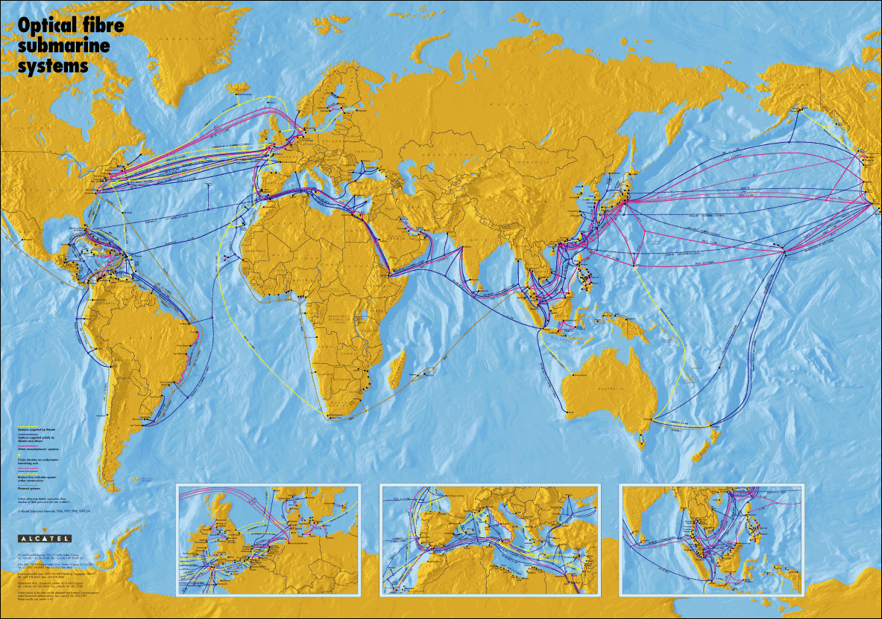
Global Undersea Fiber systems

Slide 21
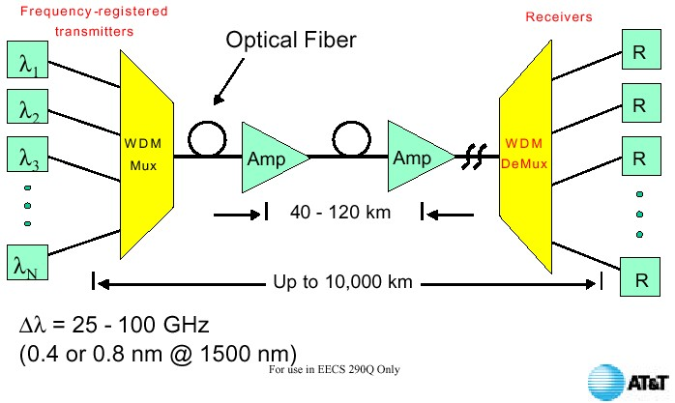
Optical Fiber System

Slide 22
Fiber Types
Modes of operation (the path which the light is traveling on)
Index profile
  Step
  Graded

Slide 23
Types Of Optical Fiber
Light
ray
n₁ core
n₂ cladding
Single-mode step-index Fiber
n_{o} air
n₁ core
n₂ cladding
Multimode step-index Fiber
n_{o} air
Variable
n
Multimode graded-index Fiber
Index profile

Slide 24
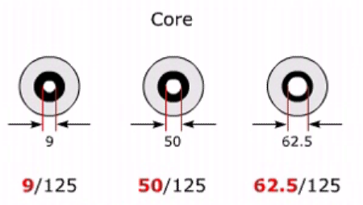
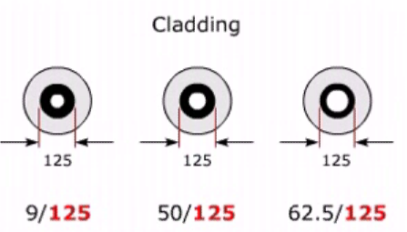
What do the fiber terms 9/125, 50/125 and 62.5/125 (micron)
Remember: A micron (short for micrometer) is one-millionth of a meter
Typically n(cladding) < n(core)

Slide 25
Single-mode step-index Fiber
Advantages:
Minimum dispersion: all rays take same path, same time to travel down the cable. A pulse can be reproduced at the receiver very accurately.
Less attenuation, can run over longer distance without repeaters.
Larger bandwidth and higher information rate
Disadvantages:
Difficult to couple light in and out of the tiny core
Highly directive light source (laser) is required
Interfacing modules are more expensive

Slide 26
Multi Mode
Multimode step-index Fibers:
  inexpensive
  easy to couple light into Fiber
  result in higher signal distortion
  lower TX rate
Multimode graded-index Fiber:
  intermediate between the other two types of Fibers

Slide 27
Acceptance Cone & Numerical Aperture
Acceptance
Cone
n₂ cladding
θ_{C}
n₁ core
n₂ cladding
If the angle too large → light will be lost in cladding
If the angle is small enough → the light reflects into core and propagates
Number of Modes (NM) :
In Step index: V²/2 ; where V=(2πα/λ); α=radius of the core
In Graded index: V²/4 ; where V=(2πα/λ); α=radius of the core
Graded index provides fewer modes!

Slide 28
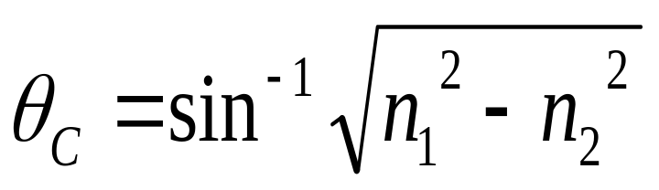
Acceptance Cone & Numerical Aperture
Acceptance
Cone
n₂ cladding
θ_{C}
n₁ core
n₂ cladding
Acceptance angle, θ_{c}, is the maximum angle in which
external light rays may strike the air/Fiber interface
and still propagate down the Fiber with <10 dB loss.
Note: n₁ belongs to core and n₂ refers to cladding)

Slide 29
Losses In Optical Fiber Cables
The predominant losses in optic Fibers are:
  absorption losses due to impurities in the Fiber material
  material or Rayleigh scattering losses due to microscopic irregularities in the Fiber
  chromatic or wavelength dispersion because of the use of a non-monochromatic source
  radiation losses caused by bends and kinks in the Fiber
  pulse spreading or modal dispersion due to rays taking different paths down the Fiber (μs/km)
  coupling losses caused by misalignment & imperfect surface finishes

Slide 30
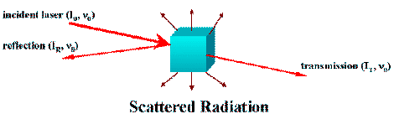
Scattering
Scattering is due to irregularity of materials
When a beam of light interacts with a material, part of it is transmitted, part it is reflected, and part of it is scattered
  Scattered light passes through cladding and is lost
Over 99% of the scattered radiation has the same frequency as the incident beam:
  This is referred to as Rayleigh scattering
A small portion of the scattered radiation has frequencies different from that of the incident beam:
  This is referred to as Raman scattering

Slide 31
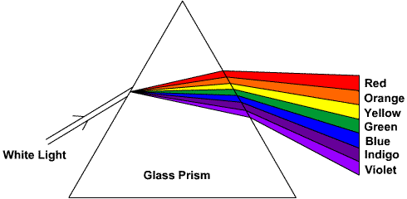
Dispersion
Dispersion is referred to widening the pulse as the light travels through the fiber optics
  A major reason for dispersion is having multimode fiber
Modal Dispersion
  Different rays arrive at different times
  The slowest ray is the one limiting the total bandwidth
  One approach is to make sure rays away from the center travel faster (graded index)
    Hard to manufacture!
    It can use LEDs rather than Laser

Slide 32
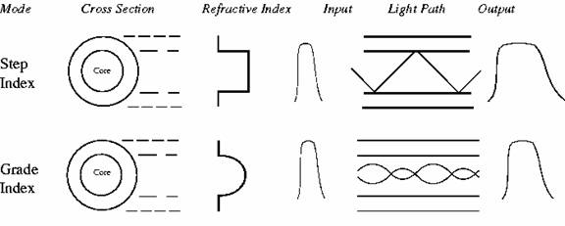
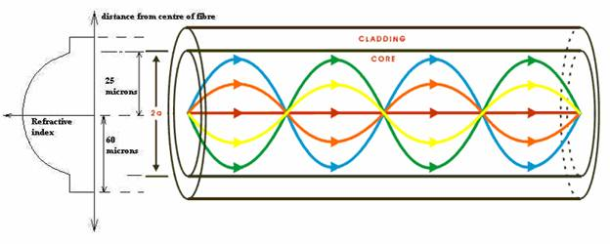
Dispersion
http://dar.ju.edu.jo/mansour/optical/Dispersion.htm

Slide 33
Dispersion
λ1
λ2
λ3
Chromatic Dispersion
  Speed of light is a function of wavelength
  This phenomena also results in pulse widening
  Single mode fibers have very little chromatic dispersion
Material Dispersion
  Index of refraction is a function of wavelength
  As the wavelength changes material dispersion varies
  It is designed to have zero-material dispersion

Slide 34
Absorption Losses In Optic Fiber
6
Windows of operation:
825-875 nm
1270-1380 nm
1475-1525 nm
Rayleigh scattering
& ultraviolet
absorption
5
Loss (dB/km)
4
3
Peaks caused
by OH⁻ ions
Infrared
absorption
2
1
0
0.7
0.8
0.9
1.0
1.1
1.2
1.3
1.4
1.5
1.6
1.7
Wavelength (μm)
Single-mode Fiber Wavelength Division Multiplexer
(980/1550nm, 1310/1550nm, 1480/1550nm, 1550, 1625nm)

Slide 35
Fiber Alignment Impairments
Axial displacement
Gap displacement
Angular displacement
Imperfect surface finish
Causes of power loss as the light travels through the fiber!

Slide 36
Wavelength-Division Multiplexing
WDM sends information through a single optical Fiber using lights
of different wavelengths simultaneously.
λ₁
Multiplexer
Demultiplexer
λ₁
λ₂
λ₂
λ₃
λ₃
λ_{n-1}
Optical
amplifier
λ_{n-1}
λ_{n}
λ_{n}
Laser
Optical sources
Laser
Optical detectors

Slide 37
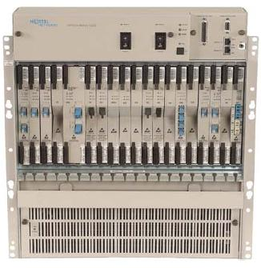
On WDM and D-WDM
Each successive wavelength is spaced > 1.6 nm or 200 GHz for WDM.
ITU adopted a spacing of 0.8 nm or 100 GHz separation at 1550 nm for dense-wave-division multiplexing (D-WDM).
WD couplers at the demultiplexer separate the optic signals according to their wavelength.
Single-mode Fiber Wavelength Division Multiplexer
(980/1550nm, 1310/1550nm, 1480/1550nm, 1550, 1625nm)
http://www.iec.org/online/tutorials/dwdm/index.html

Slide 38
Areas of Application
Telecommunications
Local Area Networks
Cable TV
CCTV
Optical Fiber Sensors

Slide 39
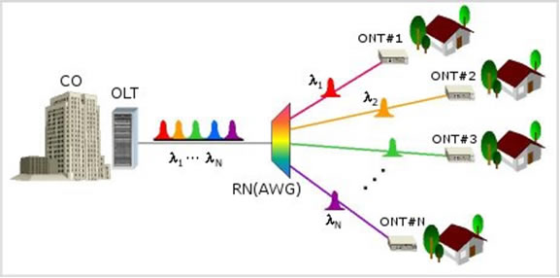
Fiber to the Home
http://www.noveraoptics.com/technology/fibertohome.php

Slide 40
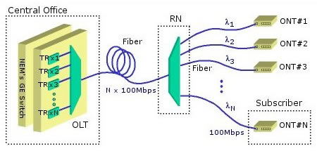
Fiber to the Home
Applications:
  HDTV (20 MB/s ) – on average three channels per family!
  telephony, internet surfing, and real-time gaming the access network (40 Mb/s)
  Total dedicated bandwidth: 100 Mb/s
  Components (single-mode fiber optic distribution network)
  optical line terminal (OLT)
  central office (CO)
  passive remote node (RN),
  optical network terminals (ONT) at the home locations

Slide 41
Fiber Distributed Data Interface (FDDI)
Stations are connected in a dual ring
Transmission rate is 100 mbps
Total ring length up to 100s of kms.
Intended to operate as LAN technology or connecting LAN to WAN
  Token ring
  Ethernet
Uses low cost fiber and can support up to 500 stations
Can be mapped into SONET

Slide 42
Token Ring
Advantages
  Long range
  Immunity to EMI/RFI
  Reliability
  Security
  Suitability to outdoor applications
  Small size
  Compatible with future bandwidth requirements and future LAN standards

Slide 43
Token Ring (Cont…)
Disadvantages
  Relatively expensive cable cost and installation cost
  Requires specialist knowledge and test equipment
  No IEEE 802.5 standard published yet
  Relatively small installed base.

Slide 44
Other Applications
Fiber Sensors
YouTube: How Fiber to home works
Youtube: Clearcurve fiber : http://www.youtube.com/watch?v=mUBRjiVhJTs&feature=related
Youtube: History of fiber and how it works
Youtube: How to build fiber optics
Youtube: Fiber optic types and fiber terms:

Slide 45
Bandwidth & Power Budget
The maximum data rate R (Mbps) for a cable of given distance D (km) with a dispersion d (μs/km) is:
R = 1/(5dD)
Power or loss margin, L_{m} (dB) is:
L_{m} = P_{r} - P_{s} = P_{t} - M - L_{sf} - (DxL_{f}) - L_{c} - L_{fd} - P_{s}  0
where P_{r} = received power (dBm), P_{s} = receiver sensitivity(dBm), P_{t} = Tx power (dBm), M = contingency loss allowance (dB), L_{sf} = source-to-Fiber loss (dB), L_{f} = Fiber loss (dB/km), L_{c} = total connector/splice losses (dB), L_{fd} = Fiber-to-detector loss (dB).
For reading only!

